Slide 1






Twitter Sentiment Analysis
NLP Model that rates sentiment in tweet depending on content

Slide 2
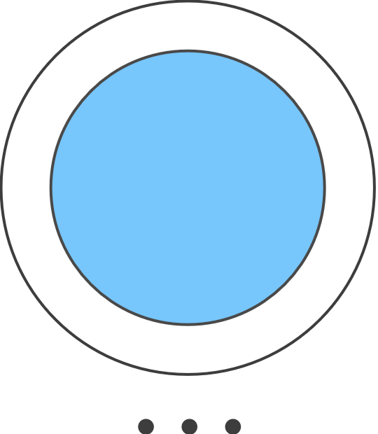




Contents
Table of Contents
01
Overview
02
Data Understanding
03
Modelling
04
Evaluation
05
Recommendation

Slide 3


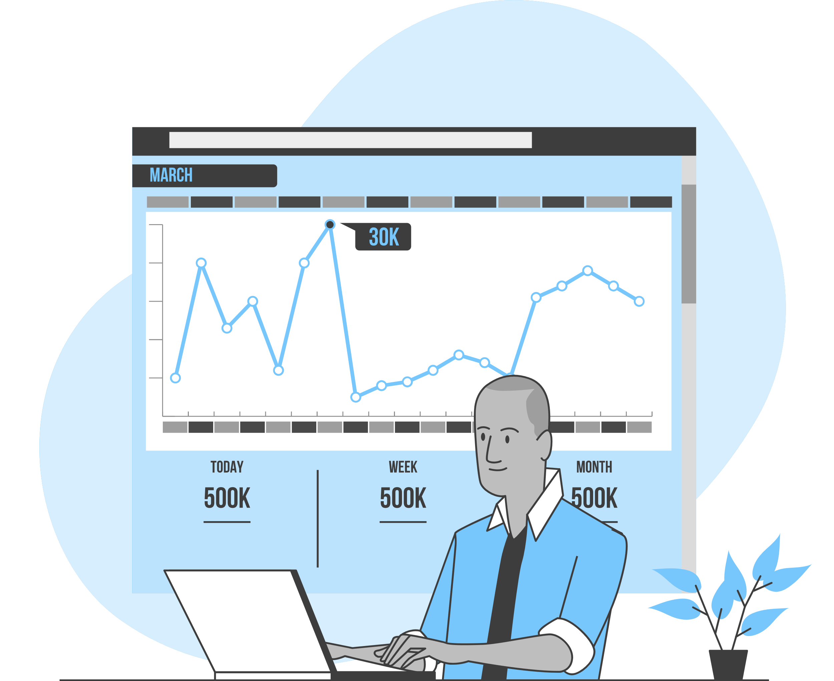



Overview
This project analyzes tweeter sentiments with the aim of building a classification model that rates text data into categories i.e Negative,Positive and Neutral
Sentiment analysis is essential to comprehending public opinion in today’s digital environment.Businesses employ this technique to extract valuable amounts of textual data including news articles,social media comments and consumer reviews.
Support vector machines(SVM) and Naïve bayes are among NLP algorithms that can be used

Slide 4
Data Understanding
The Twitter dataset contains multiple columns, including date information, but our analysis focuses solely on the text data and the sentiment column.
To prepare the data for machine learning, we: ✅ Removed duplicates to eliminate redundant information. ✅ Converted sentiment labels to integers for compatibility with ML models. ✅ Preprocessed text by:
Removing stopwords and punctuation
Applying lemmatization to normalize words
We developed and evaluated multiple models to determine the best-performing approach for sentiment classification.

Slide 5
Modelling
We trained five classification algorithms on the dataset, including Support Vector Machines (SVM), Naïve Bayes, and XGBoost, among others.
The dataset was split into training and test sets, and we utilized pipelines to streamline preprocessing, which included: ✅ Converting text data into numerical representations ✅ Using SMOTE to address class imbalance ✅ Training models on the processed data
A custom process was implemented to train models, make predictions, and compute evaluation metrics for all classifiers.
Finally, the best-performing model was fine-tuned and used for final predictions.

Slide 6
Model Evaluation
This project analyzes tweeter sentiments with the aim of building a classification model that rates text data into categories i.e Negative,Positive and Neutral
Sentiment analysis is essential to comprehending public opinion in today’s digital environment.Businesses employ this technique to extract valuable amounts of textual data including news articles,social media comments and consumer reviews.
Support vector machines(SVM) and Naïve bayes are among NLP algorithms that can be used

Slide 7
Recommendation
The Twitter dataset contains multiple columns, including date information, but our analysis focuses solely on the text data and the sentiment column.
To prepare the data for machine learning, we: ✅ Removed duplicates to eliminate redundant information. ✅ Converted sentiment labels to integers for compatibility with ML models. ✅ Preprocessed text by:
Removing stopwords and punctuation
Applying lemmatization to normalize words
We developed and evaluated multiple models to determine the best-performing approach for sentiment classification.

Slide 8




01
Company
Enter a subtitle here if you need it

Slide 9


Your logo
Our Company
Mercury is the closest planet to the sun and the smallest one in the solar system—it’s only a bit larger than the Moon. The planet’s name has nothing to do with the liquid metal, since Mercury was named after the Roman messenger god

Slide 10





Understanding the Problem
Neptune
Mercury
Jupiter
Neptune is the farthest planet from the Sun
Mercury is the smallest planet in the Solar System
Jupiter is the biggest planet in the Solar System

Slide 11
Our Solutions
Mercury
Venus
01
02
Mercury is the closest planet to the sun
Venus is the second planet from the sun
Jupiter
Neptune
03
04
Jupiter is the biggest planet of them all
Neptune is the farthest planet from the Sun

Slide 12





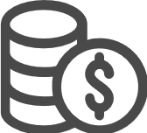
Main Competitors
 | Mercury | Jupiter | Venus | Neptune

Slide 13
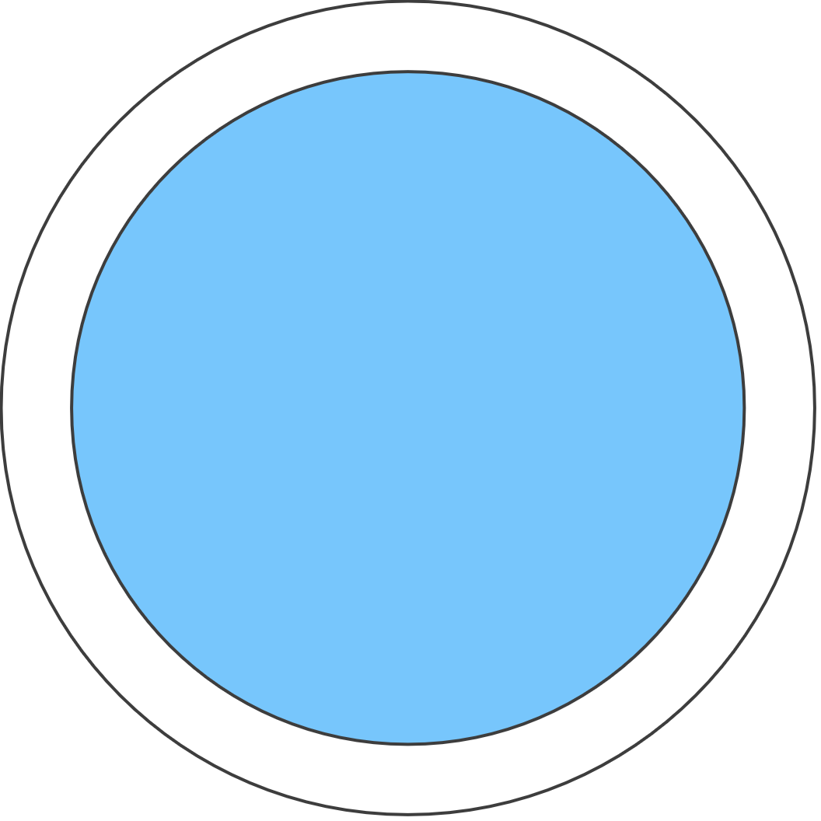
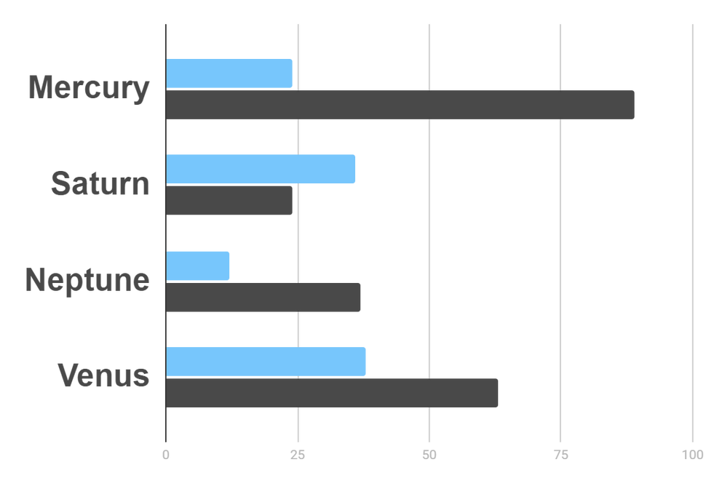
Market Research
Evolution
$20K
Gross Revenue in the Sector
10%
45K
To modify this graph, click on it, follow the link, change the data and paste the resulting graph here
Sector Growth

Slide 14






“This is a quote, words full of wisdom that someone important said and can make the reader get inspired.”
—Someone Famous

Slide 15


Awesome Words

Slide 16



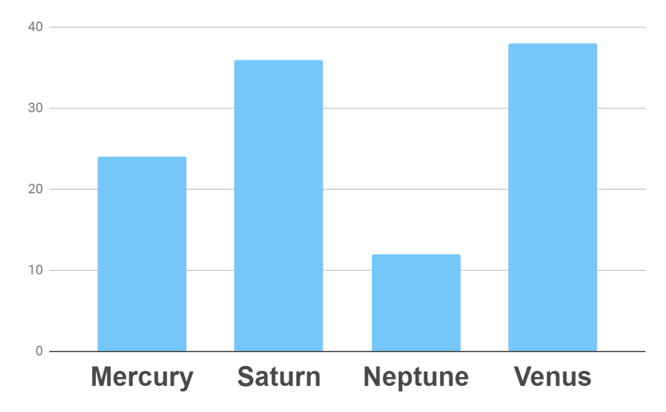
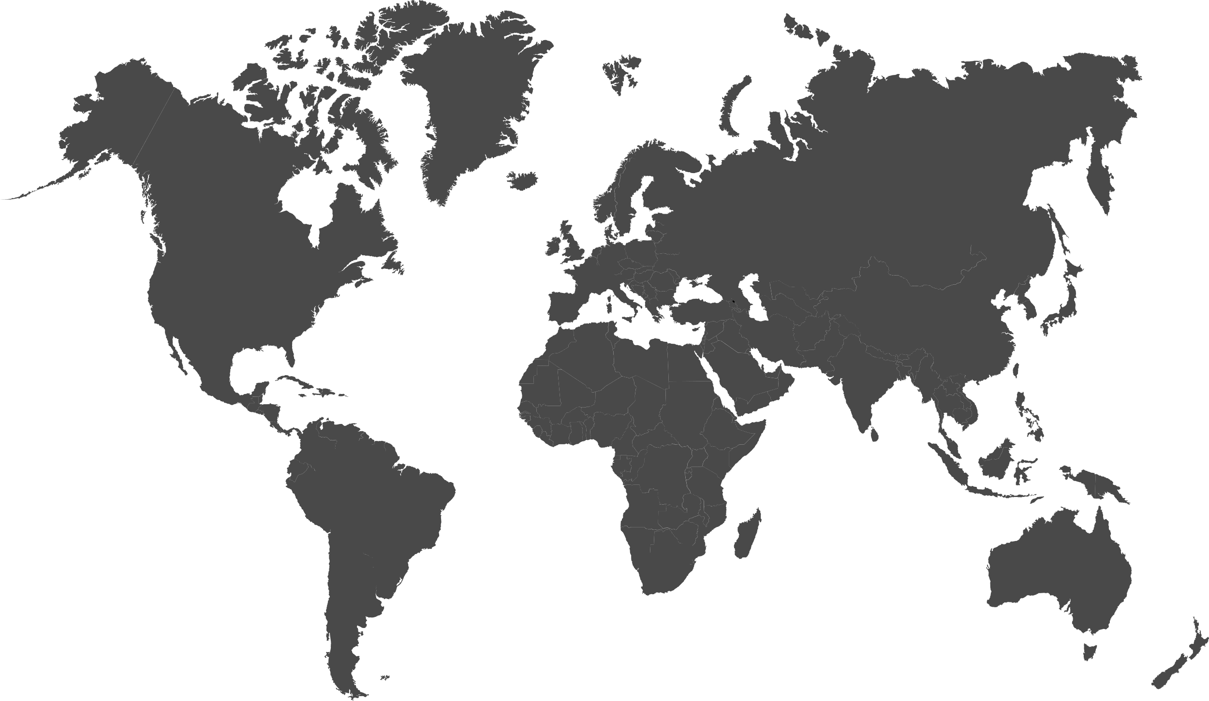


Analysis
Outreach
Top Rated Values
To modify this graph, click on it, follow the link, change the data and paste the new graph here

Slide 17

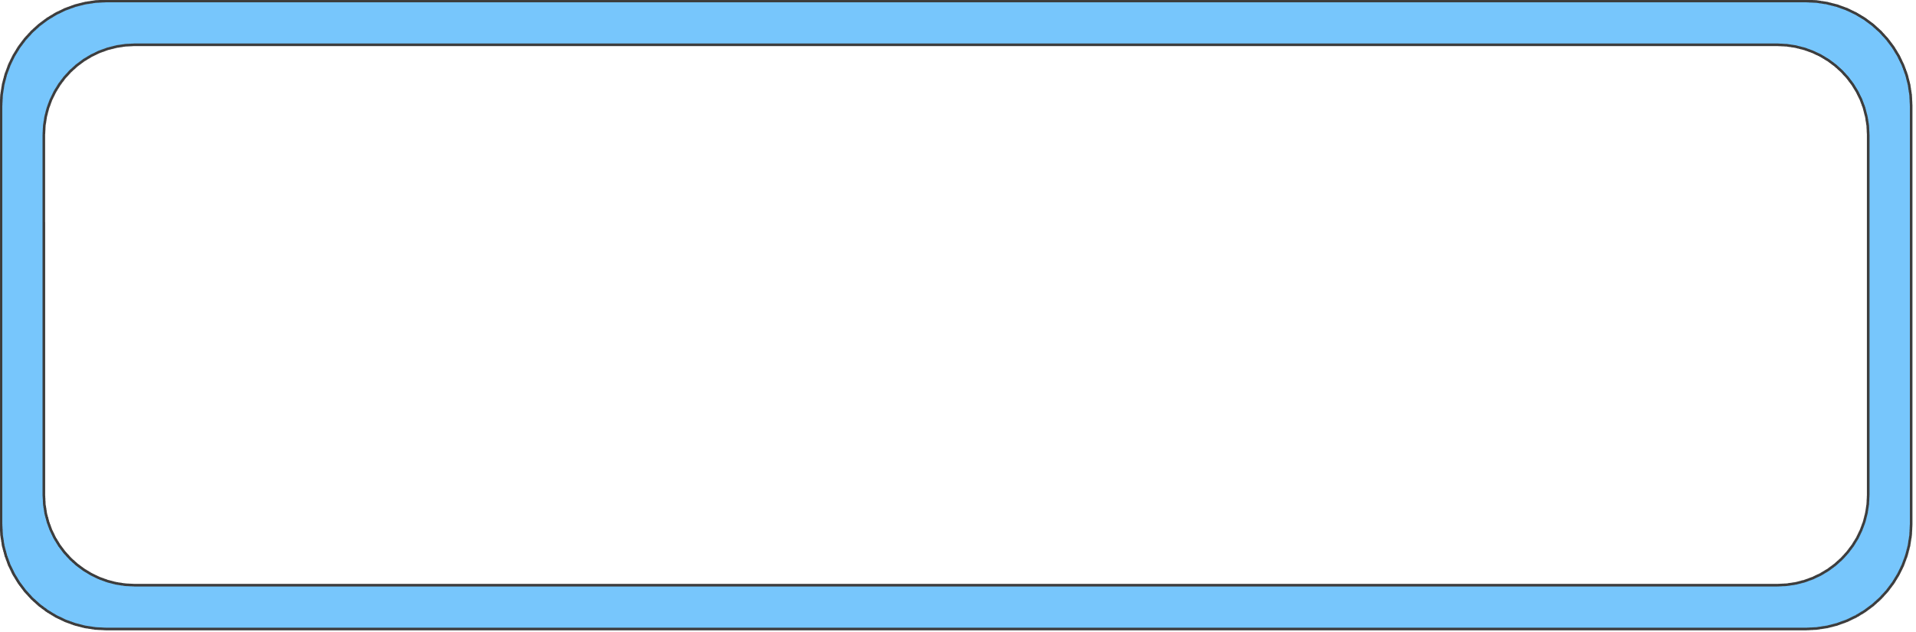




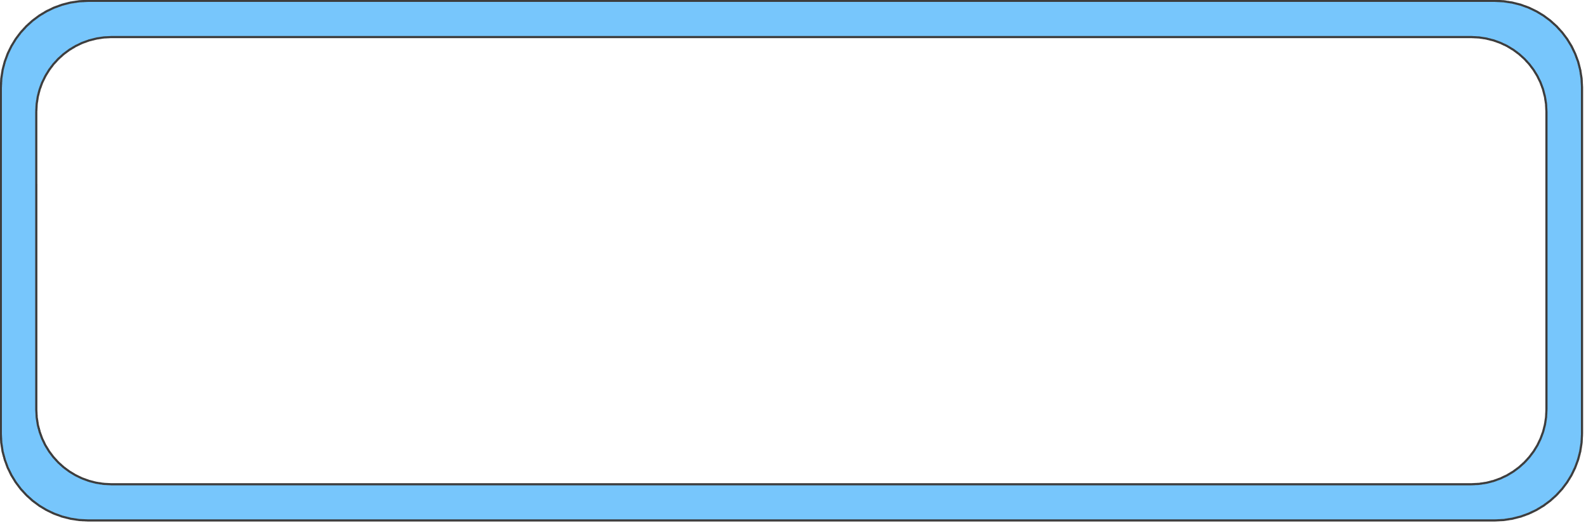


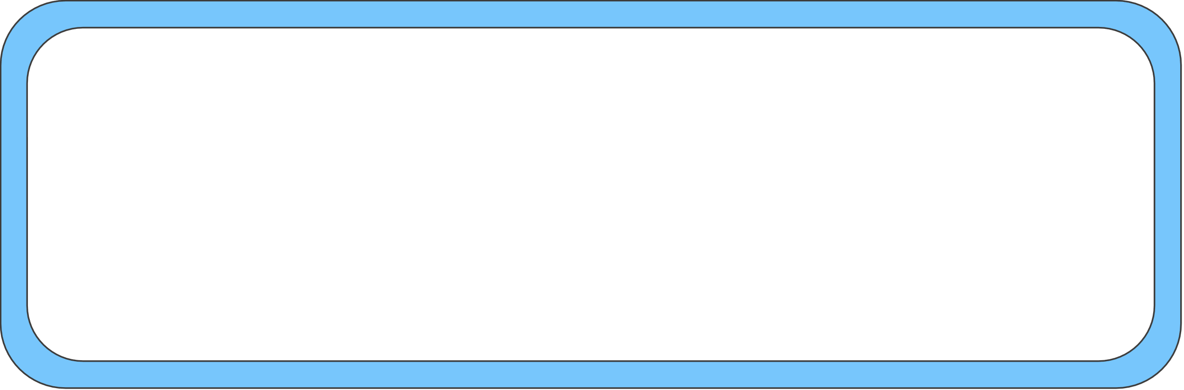



333,000.00
earths is the sun’s mass
24h 37m 23s
is Jupiter’s rotation period
386,000 km
is the distance to the Moon

Slide 18
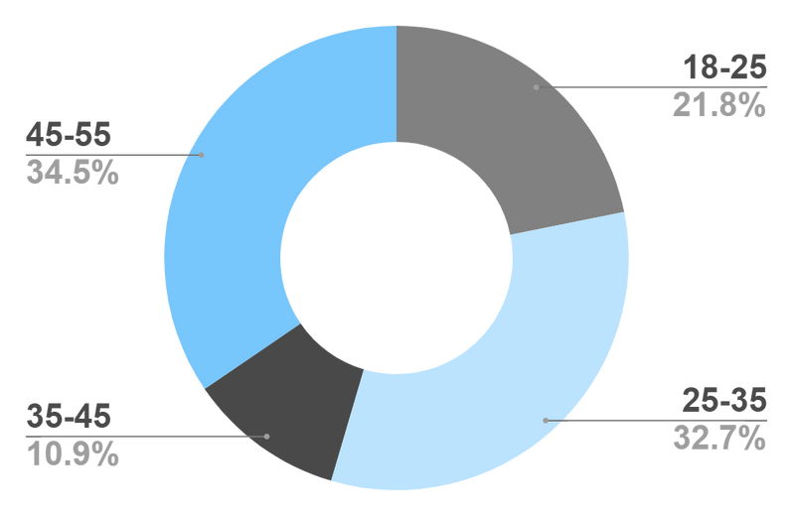








Target
Age
Gender
30%
70%
Interests
Security
Usability
To modify this graph, click on it, follow the link, change the data and paste the new graph here
Interface

Slide 19
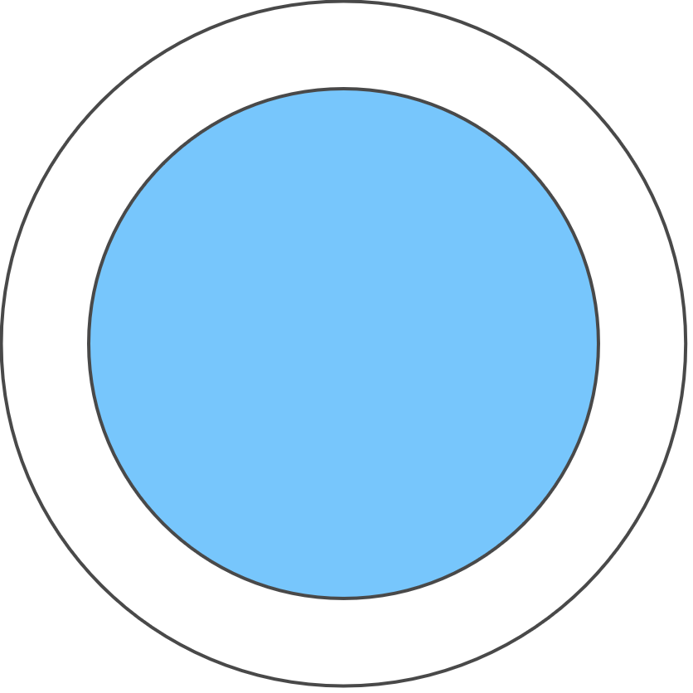


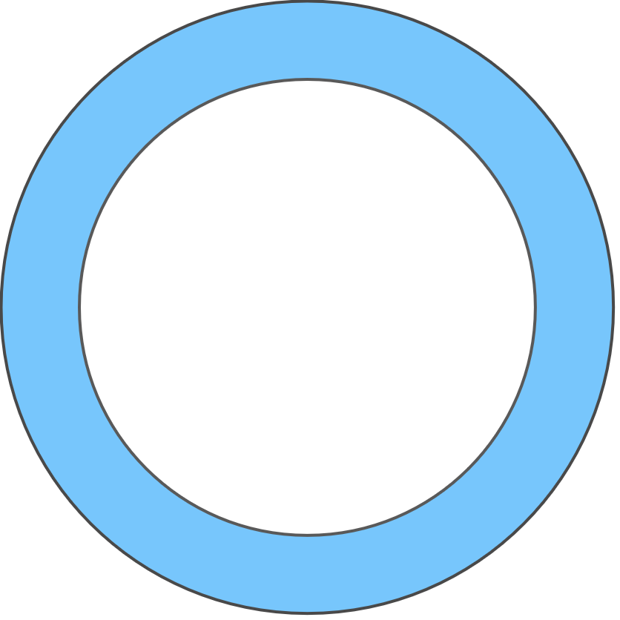
Our Process
Mercury is the closest planet to the Sun
Venus is the second planet from the Sun
Day 1
Day 2
Day 3
Day 4
Jupiter is the biggest planet in the Solar System
Neptune is the farthest planet from the Sun

Slide 20

Whoa!
This could be the part of the presentation where you can introduce yourself, write your email…

Slide 21




Our Consultants
John James
Venus is the second planet from the Sun
Jane Patterson
Joe Doe
Mercury is the closest planet to the Sun
Neptune is the farthest planet from the Sun

Slide 22





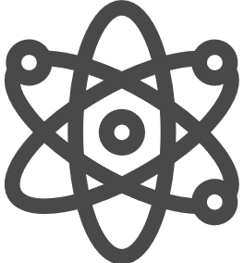
Our Partners
Mercury
Jupiter
Neptune
Mercury is the closest planet to the Sun
Jupiter is the biggest planet of them all
Neptune is the farthest planet from the Sun
Saturn
Mars
Venus
Saturn is the ringed one and a gas giant
Despite being red, Mars is actually a cold place
Venus is the second planet from the Sun

Slide 23

Testimonials
Helena James
“Mercury is the closest planet to the Sun”
Jenna Doe
“Jupiter is the biggest planet of them all “
Mary Patterson
“Neptune is the farthest planet from the Sun”

Slide 24



Awards
Mercury
It’s the closest planet to the Sun
Venus
Venus is the second planet from the Sun
Jupiter
Jupiter is the biggest planet of them all

Slide 25


498,300,000
Big numbers catch your audience’s attention

Slide 26
Upcoming Goals
January
February
March
April
Goal 1
Phase 1
Phase 2

Slide 27

A Picture Is Worth a Thousand Words

Slide 28
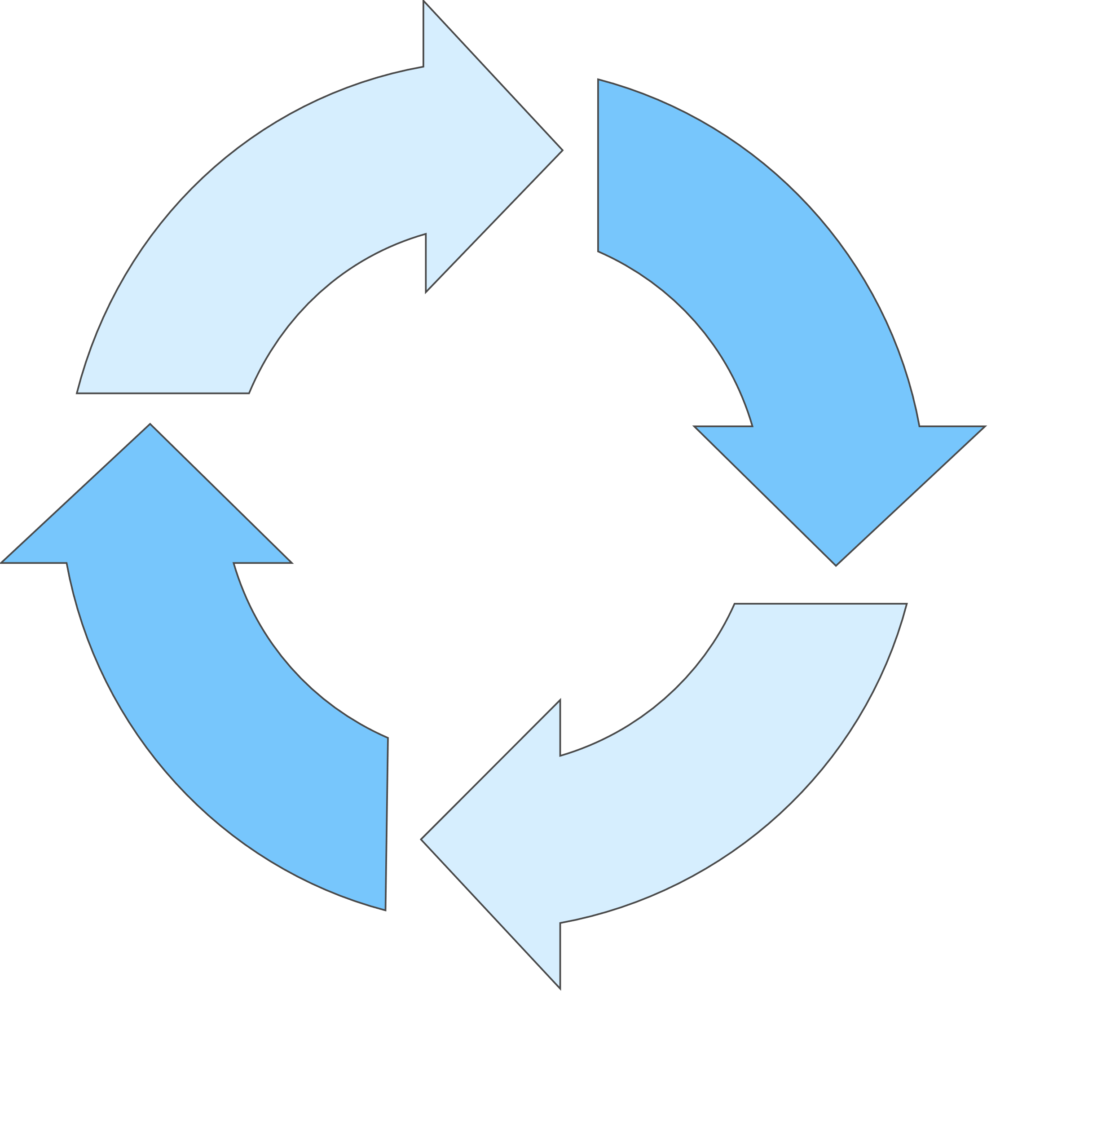




Infographics Make Your Idea
Understandable…
Mercury
Neptune
Mercury is the closest planet to the Sun
Neptune is the farthest planet from the Sun
Jupiter
Saturn
Jupiter is the biggest planet of them all
Saturn is the ringed one and a gas giant

Slide 29
…And the Same Goes for Tables
 | Mass (earths) | Diameter (earths) | Gravity (earths)
Mercury | 0.06 | 0.38 | 0.38
Mars | 0.11 | 0.53 | 0.38
Saturn | 95.2 | 9.4 | 1.16

Slide 30
Maybe You Need to Divide the Content
01
02
Neptune
Jupiter
Neptune is the farthest planet from the Sun and the fourth-largest in the Solar System
Jupiter is the biggest planet in the Solar System and the fourth-brightest one

Slide 31


Desktop Software
You can replace the image on
the screen with your own
work. Just delete this one,
add yours and center it properly

